Slide 1
Chapter Two The Main Computer Parts
By Rawan Saleh Ismael
M.Sc. Computer science

Slide 2
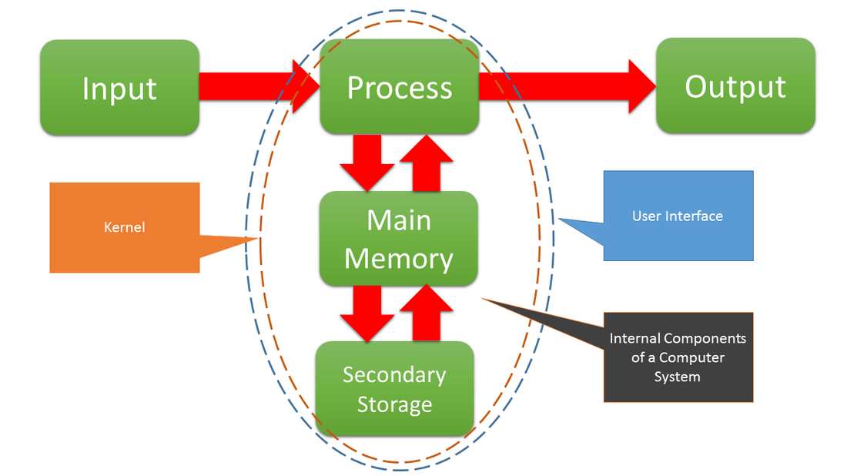

Slide 3
The main parts of computer
Hardware
Input Units
Central processing unit (CPU)
Memory unit
Secondary memory

Slide 4
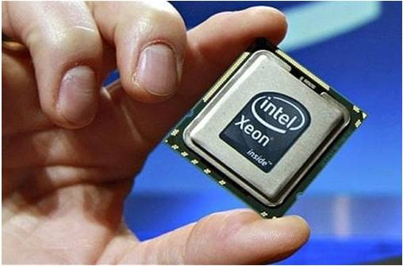
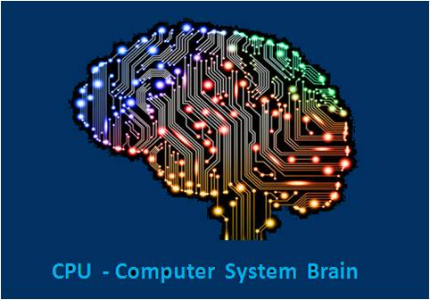
CPU:
Input units : keyboard, mouse and scanner

Slide 5
CPU: Ibrahim
brain of the computer system
Handles all instructions it receives from computer hardware and the software applications.
2 Companies: (intel ), advanced micro devises ( AMD).

Slide 6
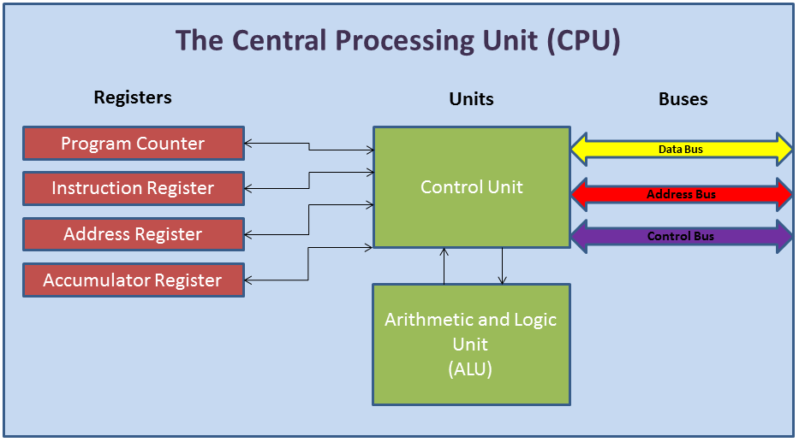
CPU Units:

Slide 7
CPU Units :
Arithmetic and Logic Unit(ALU):
Adding , multiplication … making decisions(logic)
Control Unit :
Direct input units
Direct memory unit
ALU
Output unit

Slide 8
Program Counter – stores the RAM address of the next instruction to be fetched from RAM by the control unit
Instruction Register – stores the details of the instruction currently being executed by the control unit
Address Register – stores the RAM address of the next piece of data to be fetched or stored in RAM by the control unit
Accumulator Register – stores the results of any calculations by the arithmetic and logic unit

Slide 9
Memory units:
Primary memory : main memory, internal memory
Some data sored
Mother board
RAM & ROM
Secondary memory

Slide 10
RAM
Random access memory
Stores the data temporary
Erased the data when power is off
SRAM
DRAM

Slide 11
SRAM
Static RAM
Retains its content as long as the power is on
Volatile in nature
Does not need to be refreshed
Fast but expensive
DRAM
Dynamic RAM
Contains data only … electricity is available
Slow and cheap use for pc
Need to be refreshed

Slide 12
ROM
Reed only
Information stored by manufacturer
Data still stored even after the power is off
Contains BIOS
Three Types PROM, EPROM, EEPROM

Slide 13
PROM:
Read only
Can not change the data
Written by manufacturer
Blank PROM chip …programmed by PROM programmes
Used in Pc
EPROM:
Erasable PROM
Can erase the data, change the data, ultra violet ray
Expensive
EEPROM:
Electrical Erasable PROM
Erased by electrical charges , one byte at a time

Slide 14
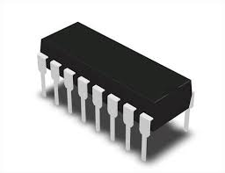
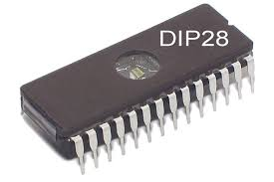
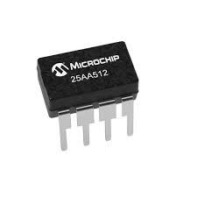

Slide 15
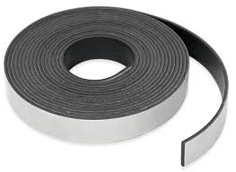
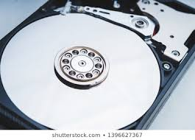
Secondary Memory
Keep the data ---- when power is off
Sequential .. Line by line ..
Magnetic tape
Direct .. Directly find the data ..
Magnetic disk
Hard disk
Floppy disk
Optical disk
Zip disk
Flash

Slide 16
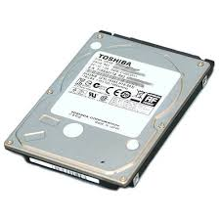
Hard Disk
Installed inside the motherboard
Stored all the data
Comes fixed … and removable
250 GB … 2 T
Divided to C:\ , D:\ …
Floppy Disk
Transfer the data
removable
Read and write by Floppy disk drive
Not used
Zip Disk
Thicker than Floppy disk
Greater in capacity
Flash
Transfer the data
Mobile
64 MB to 32 GB

Slide 17
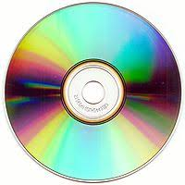
Optical disk
Small size and huge storage
Read and write
CD , DVD
CD : compact disk ,
store data like music
80 minutes , 700 MB
CD ROM, CD R/W
DVD: Digital Versatile Disk
High capacity storage
Store movie…
4.7 GB
DVD ROM, DVD R/W

Slide 18
Output Units
Monitor, printer, speaker
Software
System software
Application software

Slide 19
http://www.belpercomputing.com/year-10/ocr-gcse-computer-science/term-1/inside-the-cpu/
https://www.learncomputerscienceonline.com/central-processing-unit/

